Slide 1
ADVANCED JAVA
III B Tech I Semester
PVP23 Regulations
Course Code |  | Year | III | Semester | I
Course Category | PC | Branch | IT | Course Type | Theory
Credits | 3 | L-T-P | 3-0-0 | Prerequisites | JAVA
Continuous Internal Evaluation : | 30 | Semester End Evaluation: | 70 | Total Marks: | 100

Slide 2
Course Outcomes:
Course Outcomes (Cos) are narrower statements that describe what students are expected to know, and be able to do at the end of each course.
Course Outcomes |  | Blooms Level
Upon successful completion of the course, the student will be able to:
CO1 | Understand the basic concepts of web design for the efficient development of web applications. | L2
CO2 | Apply JDBC concepts to perform database operations using different types of JDBC statements, handle result sets, and manage transactions. | L3
CO3 | Design and develop dynamic web applications using Servlets and JSP. | L3
CO4 | Apply the basic concepts of the Spring framework to develop web applications. | L3

Slide 3
PO’s:
1) Engg. Knowledge, 2) Problem Analysis, 3) Design/Development of Solutions, 4) Investigation, 5) Modern Tool Usage, 6) The Engineer & Society, 7) Environment and Sustainability, 8) Ethics, 9) Individual and Teamwork, 10) Communication, 11) Project Management, 12) Life-long Learning
Contribution of Course Outcomes towards achievement of Program Outcomes & Strength of correlations (3:Substantial,2:Moderate,1:Slight)
 | PO1 | PO2 | PO3 | PO4 | PO5 | PO6 | PO7 | PO8 | PO9 | PO10 | PO11 | PO12 | PSO1 | PSO2
CO1 | 3 |  |  |  |  |  |  |  |  |  |  |  | 3 | 3
CO2 |  |  | 3 |  | 3 |  |  |  |  |  |  |  | 3 | 3
CO3 |  |  | 3 |  | 3 |  |  |  |  |  |  |  | 3 | 3
CO4 |  |  | 3 |  | 3 |  |  |  |  |  |  |  | 3 | 3
Avg. | 3 |  | 3 |  | 3 |  |  |  |  |  |  |  | 3 | 3

Slide 4
Syllabus
UNIT 1 : JDBC Programming: JDBC Architecture, Exploring JDBC Drivers, Exploring major JDBC Classes and Interfaces, Understanding basic JDBC steps, Creating simple JDBC Application, Working with PreparedStatement, working with CallableStatement, Working with ResultSet, Working with Batch updates: Using batch updates with the Statement object, Working with transactions: ACID properties, Types of transactions, Transaction Management.
UNIT 2: J2EE and Web Development: Exploring enterprise architecture types, Describing EE6 containers, Types of Servers in J2EE Applications, Exploring the HTTP protocol: Describing HTTP requests, Introducing web applications: Describing components of a web application, Describing structure, Describing web containers, Exploring web architecture models: Model-1 architecture, Model-2 architecture and MVC architecture.

Slide 5
UNIT 3: Servlet API and Overview: Exploring the features of JAVA servlet: Servlet a request-response model, servlet and environment state, Security features, HTML-aware servlets, HTML-specific servlets, Performance features, 3-tier applications, Exploring the Servlet API, Explaining the Servlet Life Cycle(SLC), Creating a sample servlet: Exploring directory structure, configuring the servlet, packaging, deploying and running the Web application, Working with ServletContext and ServletConfig Objects, Working with the HttpServletRequest and HttpServletResponse interfaces: Using the HttpServletRequest interfaces(the role of form data, form data and parameters, headers, File uploads), Using HttpServletResponse interface(Response header, response redirection), Exploring session tracking mechanisms: using Cookies, Hidden Form Fields and URL Rewriting, Creating a session using HTTPSession interface.

Slide 6
UNIT 4: Java Server Pages(JSP): Introduction to JSP technology, advantages of JSP over JAVA servlet, JSP Architecture, JSP: Life Cycle, Working with JSP basic tags and implicit objects: Exploring scripting tags (scriptlet, declarative, expression), Exploring implicit objects(request, response, out, page, pageContext, application, session, config, exception), Exploring directive tags ( page, include, taglib), Working with JSP action tags: Exploring action tags(<jsp:include>, <jsp:forward>, <jsp:param>, <jsp:plugin>,<jsp:useBean>, <jsp:setProperty>, <jsp:getProperty>), JSP Standard Tag Libraries(JSTL): Working with core tag library. CRUD application with JSP.
UNIT 5: Java Web Frameworks: Working with Spring: Introducing the features of the Spring framework, Exploring the Spring Framework Architecture, Sprint Container, Exploring Dependency Injection, Constructor Injection, Setter Injection, Inversion of Control, and Spring annotation based Configurations, Spring MVC life cycle.

Slide 7
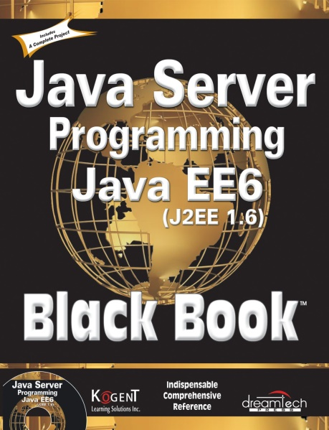
Text Books:
Black Book “Java Server Programming Java EE6”, Dream Tech Publishers, 2012.

Slide 8
JDBC
JDBC (Java Database Connectivity) is a Java API that enables Java applications to connect and interact with databases.
It provides a standard interface for accessing relational databases (such as MySQL, Oracle, PostgreSQL, SQL Server, etc.) using SQL queries.
Key Characteristics:
  Supports portability
  Connect to a database
  Send SQL queries (like SELECT, INSERT, UPDATE, DELETE)
  Retrieve and process the results
  Handle database transactions

Slide 9
Components of JDBC
4 Main Components
  The JDBC API – The JDBC API Provides various methods and interfaces for easy and effective communication with databases. (java.sql.*,javax.sql.*) – DriverManager, Driver, Connection
    Statement, PreapredStatement, CallableStatement, ResultSet.
  JDBC DriverManager - JDBC DriverManager JDBC Driver manager loads the database-specific driver into an application in order to establish the connection with the database.

Slide 10
  JDBC Test suite: JDBC Test suite facilitates the programmer to test the various operations such as deletion, updation, insertion that are being executed by the JDBC Drivers or not
  JDBC-ODBC Bridge Drivers: JDBC-ODBC Bridge Drivers are used to connect the database drivers to the database. The bridge does the translation of the JDBC method calls into the ODBC method call.

Slide 11
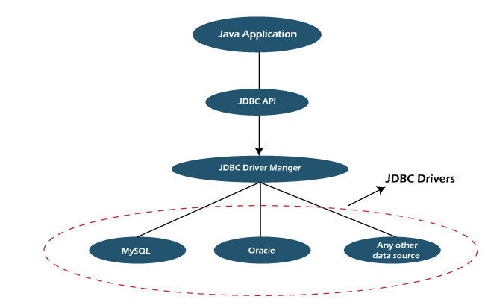
JDBC Architecture
JDBC API: Provides classes and interfaces to connect with databases. Some of the important classes and interfaces defined in JDBC architecture in Java are DriverManager class, Connection Interface, etc.

Slide 12
JDBC Architecture
DriverManager : DriverManager class in the JDBC architecture is used to establish a connection between Java applications and databases.
Using the getConnection() method of this class a connection is established between the Java application and data sources

Slide 13
JDBC Architecture
JDBC Drivers : JDBC drivers are used to connecting with data sources.
All databases like Oracle, MSSQL, MYSQL, etc. have their drivers, to connect with these databases we need to load their specific drivers.
Class is a Java class used to load drivers. Class.forName() method is used to load drivers in JDBC architecture

Slide 14
JDBC Architecture
Data Sources : Data Sources in the JDBC architecture are the databases that we can connect using this API.
These are the sources where data is stored and used by Java applications.
JDBC API helps to connect various databases like Oracle, MYSQL, MSSQL, PostgreSQL, etc.

Slide 15
JDBC Architecture
Summary:
JDBC API simplifies database connection.
DriverManager class manages database connections.
JDBC Drivers link Java with databases.
Data Sources are the actual databases.

Slide 16
Types of Drivers
There are 4 different types of Drivers available in JDBC. They are classified based on the techniques which are used to access a Database.
They are as follows:
  Type I : JDBC- ODBC Bridge or Bridge Driver
  Type II: Partly Java and Partly Native Code Driver (Native – API partly JAVA Driver)
  Type III: Pure JAVA driver that uses middleware driver to connect to database (Network Protocol Driver)
  Type IV: Thin Driver- Pure Java Driver which is directly connected to database.

Slide 17
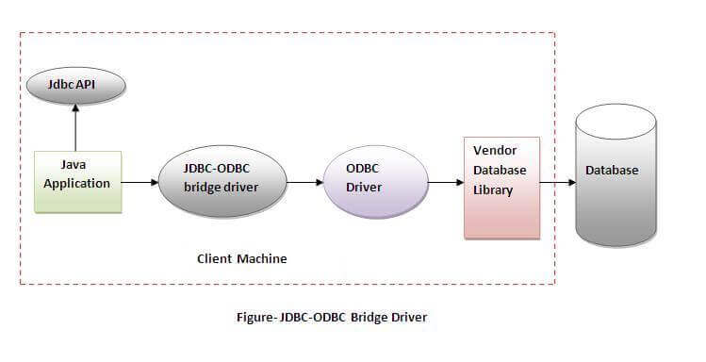
Type -1 Driver - JDBC ODBC Bridge Driver

Slide 18
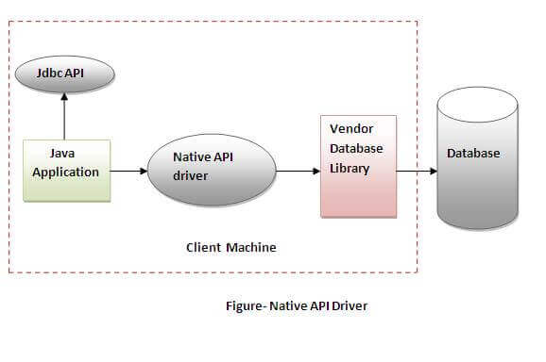
Type -2 Driver - Native API Driver

Slide 19
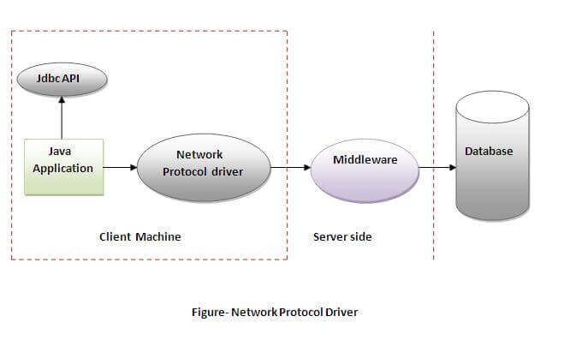
Type -3 Driver - Network Protocol Driver
Only one driver for accessing all databases.

Slide 20
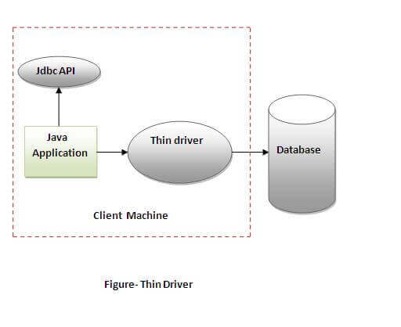
Type -4 Driver – Thin Driver

Slide 21
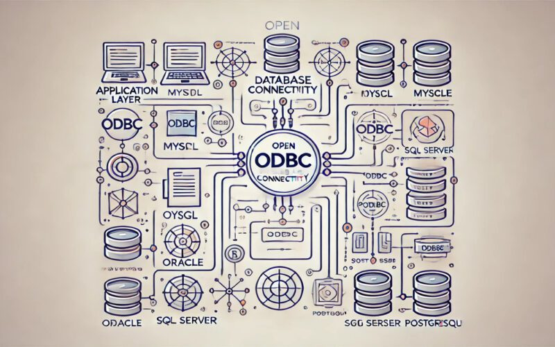
Pros & Cons
1. JDBC-ODBC bridge driver:
    JDBC-ODBC bridge driver is a native driver which uses ODBC driver to connect with the database.
    It converts JDBC method calls into ODBC calls.
    It is also known as Type 1 driver.
  Advantages:
    It can be used with any database for which an ODBC driver is installed.
    Easy to use
  Disadvantages:
    Performance is not good as it converts JDBC method calls into ODBC calls.
    Platform dependent because ODBC is mainly supported by Windows and different ODBC drivers are there for different databases.

Slide 22
2. Native-API driver:
  Native-API driver uses the client-side libraries of the database. It converts JDBC method calls into native calls(Calls understood by the database) of the database API.
  It is partially written in Java. It is also known as Type 2 driver.
Advantages:
  It is faster than a JDBC-ODBC bridge driver. Because JDBC calls are directly into database specific calls.
  Portability is more compared to Type-1
Disadvantages:
  Type 2 drivers are different for different platforms. (may be today Oracle, next day I use DB2… compulsory we have to change driver)
  Platform dependent(because it use native library).
  The vendor client library needs to be installed on the client machine.

Slide 23
3. Network-Protocol driver:
  Network-Protocol driver is a pure Java driver which uses a middle-tier to converts JDBC calls directly or indirectly into database specific calls.
  Multiple types of databases can be accessed at the same time. It is a platform independent driver. It is also known as Type 3 or Middle-Ware driver.
Advantages:
  Platform independent(One driver is sufficient for all databases).
  Faster than Type1 and Type2 drivers.
  It follows a three tier communication approach.
  Multiple types of databases can be accessed at the same time.
Disadvantages:
  It requires database-specific coding to be done in the middle tier.

Slide 24
4. Thin driver:
  Thin driver is a pure Java driver which converts JDBC calls directly into the database specific calls.
  It is a platform independent driver. It is also known as Type 4 or Database-Protocol driver.
Advantages:
  Platform independent.
  Faster than all other drivers.
Disadvantages:
  Multiple types of databases can’t be accessed at the same time.

Slide 25
Steps
1. Load and Register the Driver
2. Establish a connection
3. Create the statement and execute the statement
4. Process the results
5. Close the connection

Slide 26
Connection (using NOTEPAD)
Installation
To connect Java application with the mysql database, mysqlconnector.jar file is required to be loaded.
  download the jar file mysql-connector.jar
Procedure to load the jar file:
  Paste the mysqlconnector.jar file in jre/lib/ext folder
    Download the mysqlconnector.jar file. Go to jre/lib/ext folder and paste the jar file here. (if JRE is not available paste in JAVA folder)
  Set classpath
There are two ways to set the classpath:
  Temporary
    C:>set classpath=c:\folder\mysql-connector;.;
  Permanent
    Go to environment variable then click on new tab. In variable name write classpath and in variable value paste the path to the mysqlconnector.jar file by appending mysqlconnector.jar;.; as C:\folder\mysql-connector.jar;.;

Slide 27
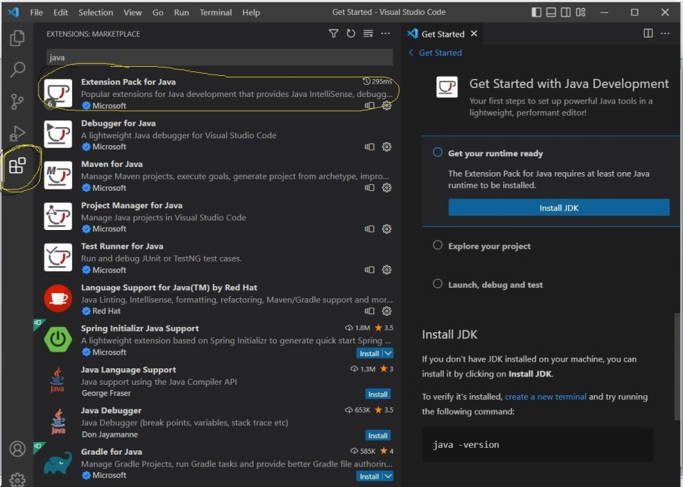
ECLIPSE
  Store connector.jar file in some location
  Click right click on Project folder,
    Chose Build Path
      Chose
        Add External Archives /Configure Build Path
        Configure Build Path
          In Libraries, click on Classpath, Add External JARs
Visual Studio Code
  Download and Install
  Add JAVA extension pack
  Chose Explorer
    Chose Create JAVA Project

Slide 28
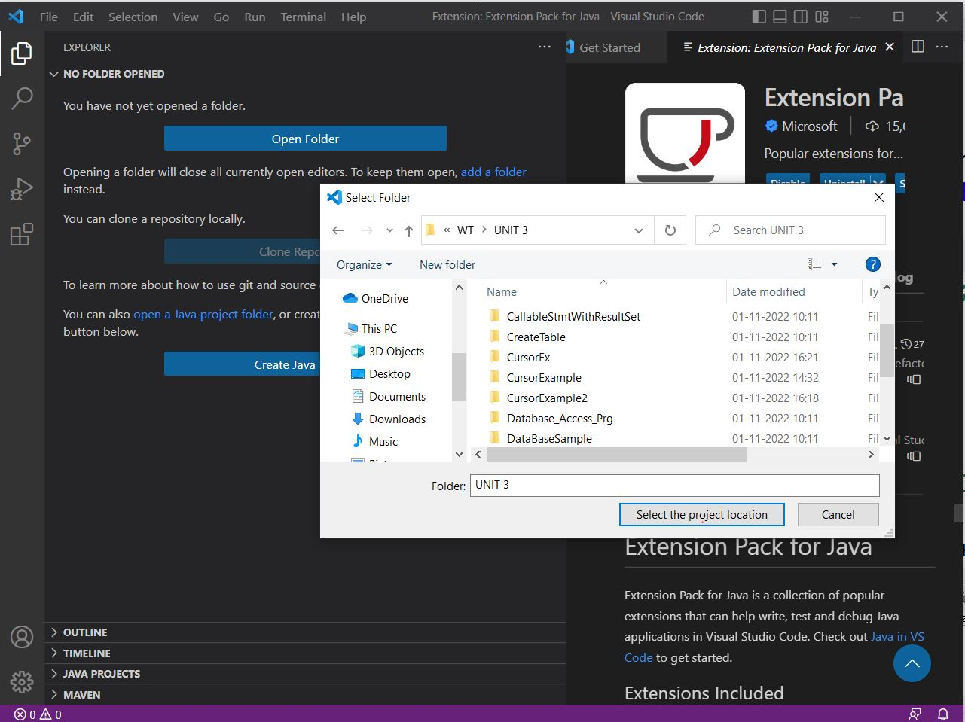
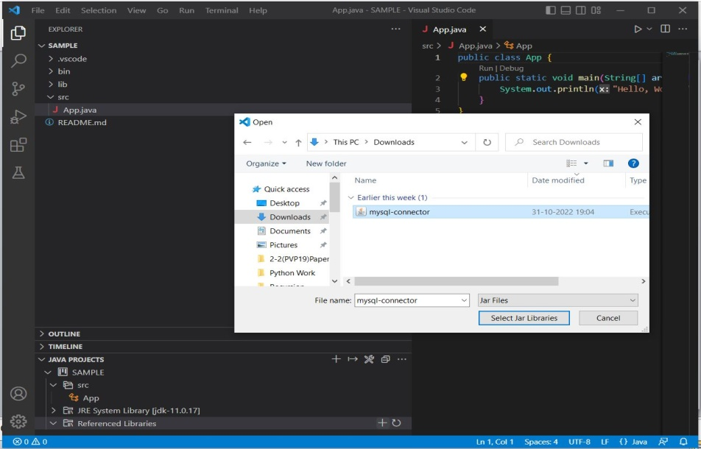
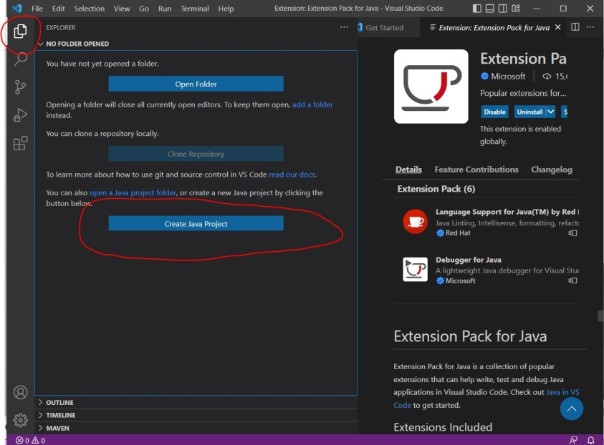
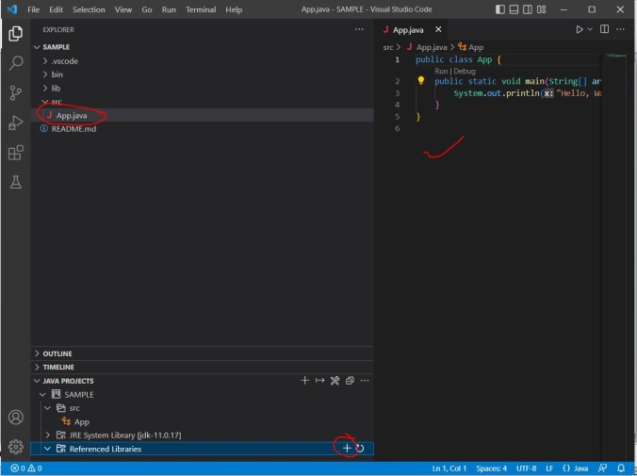
Create JAVA Project
Then Chose the type of Project and Location
Once the location is selected, Specify the name of the Project, then JAVA project will be created and by default APP.java file will be created, Next Add jar file in referenced libraries.

Slide 29
JDBC API
Provides classes and interfaces that are used by Java Applications to communicate with databases.
The JDBC driver communicates with a database for any requests made by a Java application by using the JDBC API.
The JDBC driver not only process SQL commands, but also sends back the result of processing of these SQL commands.
JDBC follows write once run anywhere behaviour of JAVA.
The JDBC API is part of Java SE and is available to Java Platform EE.
Textbook - JDBC 4.0
JDBC 4.0 mainly uses two packages:
  java.sql
  javax.sql

Slide 30
java.sql package
Also called as JDBC Core API.
Package contains classes and interfaces to perform JDBC operations such as creating and executing SQL queries.
These classes and interfaces further classified into:
  Connection management – establish a connection with database
  Database access – Execution of SQL Queries- after connection is established
  Data types- SQL Datatypes (Ex: BLOB,CLOB, UDT – User Defined Datatype....)
  Database metadata – is used to retrieve info about Database
  Exceptions and warnings – handle unwanted exceptions raised by the application

Slide 31
javax.sql package
Also called as JDBC Extension API (supplement of java.sql package).
primarily focusing on advanced data source management , connection pooling, and distributed transaction support.
This package is especially useful in enterprise applications where performance, scalability, and manageability of database connections are crucial.
Classified into
  Connection and statement pooling – establish number of connections
  Distributed transaction – supports accessing of data from multiple servers
  Rowsets – Alternative to ResultSet in SQL package - Useful in distributed systems, where you fetch data once, disconnect, and later work with the data.

Slide 32
Exploring Major Classes and Interfaces
Major classes and interfaces:
  DriverManager Class
  Driver Interface
  Connection Interface
  Statement Interface
  ResultSet Interface
These classes and interfaces allows us to load a driver, establish a connection, and retrieve or update data in a database.

Slide 33
JDBC Application Architecture
Application
Connection
Statement
ResultSet
Driver Manager
Driver
Driver
Driver
DataSource
DataSource
DataSource

Slide 34
DriverManager Class
The DriverManager class is a core component of the JDBC API (java.sql package).
It manages a list of database drivers and is responsible for establishing a connection to a database.
It acts as a bridge between Java applications and database drivers.
Method Name | Description
static Connection void getConnection (String url) | It tries to establish the connection to a given database URL
static Connection getConnection (String url, Sting user, String password) | It tries to establish the connection to a given database URL.

Slide 35
static Connection getConnection(String url, Properties info) | It tries to establish the connection to a given database URL. Property is in the form of Object . Properties p=new Properties(); p.put(“user”,”root”); p.put(“password”,”admin”); Connection cn=DriverManager.getConnecton(“URL”,p);
static Drivers[] getDrivers() | It retrieves the enumeration of the drivers which has been registered with the DriverManager class
static Driver getDriver(String URL) | Given a URL, this method returns a driver that can understand URL
Static void deregisterDriver(Driver) | Unregisters the driver
Sttic void registerDriver(Driver) | Registers the driver

Slide 36
JDBC Database URL
jdbc:mysql: //host_name: port / database_name
The communication
protocol
The machine
holding the
database.
The port
used for the
connection.
The path to
the database
on the machine
e.g. jdbc:mysql://localhost:3306/JDBC

Slide 37
import java.sql.Connection;
import java.sql.DriverManager;
import java.sql.ResultSet;
import java.sql.Statement;
public class DriverManagerExample {
public static void main(String[] args) {
try {
// 1. Load the JDBC driver
Class.forName("com.mysql.cj.jdbc.Driver");
// 2. Establish a connection
Connection conn = DriverManager.getConnection(
"jdbc:mysql://localhost:3306/JDBC", "root", "password"
);
// 3. Create a statement and execute a query
Statement stmt = conn.createStatement();
ResultSet rs = stmt.executeQuery("SELECT * FROM EMP");
// 4. Process the result
while (rs.next()) {
System.out.println(rs.getString("name"));
}
// 5. Close resources
rs.close();
stmt.close();
conn.close();
} catch (Exception e) {
e.printStackTrace();
}
}
}

Slide 38
Driver Interface
The Driver interface is part of the java.sql package in JDBC and is the core interface for JDBC drivers.
As a developer, we don’t typically implement the Driver interface; JDBC drivers like MySQL's com.mysql.cj.jdbc.Driver or Oracle's oracle.jdbc.OracleDriver implement it.
.
+-------------------+
| java.sql.Driver |
+-------------------+
^
|
+----------------------------------+
| com.mysql.cj.jdbc.Driver | (Example: MySQL Driver)
+----------------------------------+
|
Implements Driver methods

Slide 39
Responsibilities
Load Driver Classes - Class.forName()
Establish Connections
Check URL CompatibilityProvide Driver Metadata
Supports Auto-registration - In modern JDBC (4.0 and later), manual loading (Class.forName()) is often not required because the driver registers itself automatically using the Java Service Provider Interface (SPI).

Slide 40
Method | Description
public boolean acceptsURL(String url) | Checks whether the format of the given URL is according to the format or not.
public abstract Connection connect(String url, Properties info) | Try to make a database connection to the given URL.
public abstract int getMajorVersion() | Get the driver's major version number.
public abstract int getMinorVersion() | Get the driver's minor version number.
public abstract boolean jdbcCompliant() | Report whether the Driver is a genuine JDBC driver or not.

Slide 41
Example JDBC Drivers Implementing Driver Interface
Database | Driver Class
MySQL | com.mysql.cj.jdbc.Driver
Oracle | oracle.jdbc.OracleDriver
PostgreSQL | org.postgresql.Driver
SQL Server | com.microsoft.sqlserver.jdbc.SQLServerDriver
SQLite | org.sqlite.JDBC

Slide 42
Connection Interface - java.sql.Connection
The Connection interface is one of the core interfaces in the JDBC API (java.sql package).
It represents an active connection between a Java application and a database server.
Once a connection is established, We can use it to:
  To Execute SQL queries - Creates Statement, PreparedStatement, and CallableStatement objects to execute SQL queries.
  Manage transactions - Allows us to commit or rollback transactions.
  Retrieve database metadata – Provides database details using DatabaseMetaData
  Manage savepoints and rollback operations

Slide 43
Key Methods in Connection Interface
Method Signature | Purpose
Statement createStatement() | Creates a simple SQL statement.
PreparedStatement prepareStatement(String sql) | Creates a precompiled SQL statement.
CallableStatement prepareCall (String sql) | Creates a callable statement for stored procedures.
void commit() | Commits the current transaction.
void rollback() | Rolls back the current transaction.
void setAutoCommit(boolean autoCommit) | Enables/disables auto-commit mode.
boolean getAutoCommit() | Checks whether auto-commit is enabled.

Slide 44
Key Methods in Connection Interface
DatabaseMetaData getMetaData() | Retrieves metadata about the database.
Savepoint setSavepoint() | Creates a new savepoint in the transaction.
void releaseSavepoint(Savepoint savepoint) | Releases a previously defined savepoint.
void rollback(Savepoint savepoint) | Rolls back the transaction to a specific savepoint.
void close() | Closes the connection.
boolean isClosed() | Checks if the connection is closed.

Slide 45
Who will implement Connection interface
The Connection interface is part of the JDBC API (java.sql.Connection), and it is implemented by the JDBC driver vendors, such as Oracle, MySQL, PostgreSQL, SQL Server, etc.
When you call DriverManager.getConnection(), the driver returns its own implementation of the Connection interface, which handles communication with the database.
Ex:
Database | Driver Class | Connection Implementation Class
MySQL | com.mysql.cj.jdbc.Driver | com.mysql.cj.jdbc.ConnectionImpl
Ex ProgramConnectionInterfaceImplementorClass.java

Slide 46
Statement Interface
The Statement interface in JDBC (java.sql package) is used to execute SQL queries against a database.
It is one of the primary interfaces to send SQL statements (queries, updates, and DDL commands) from a Java application to a relational database.
Feature | Description
Execute SQL Queries | Executes static SQL queries (SELECT, INSERT, UPDATE, DELETE).
Execute DDL Commands | Executes schema-related SQL commands (CREATE, DROP, ALTER).
Execute Batch Queries | Supports executing multiple SQL queries as a batch
Retrieve Results | Returns ResultSet objects for queries like SELECT.
Supports Simple Statements | Suitable for SQL statements without parameters.

Slide 47
Key Methods
Method Signature | Purpose
ResultSet executeQuery(String sql) | Executes a SELECT query and returns a ResultSet.
int executeUpdate(String sql) | Executes INSERT, UPDATE, DELETE returns affected rows.
boolean execute(String sql) | Executes any SQL command. Returns true if it produces a ResultSet.
void close() | Closes the statement and releases resources.
void addBatch(String sql) | Adds SQL commands to a batch.
int[] executeBatch() | Executes all SQL commands added in the batch.
void clearBatch() | Clears the current batch of SQL commands.
void setMaxRows(int max) | Limits the number of rows a ResultSet can return.
Connection getConnection() | Gets the Connection that created this statement.

Slide 48
A Simple JDBC application
import java.sql.*;
public class jdbctest {
public static void main(String args[]){
try{
Class.forName("com.mysql.jdbc.Driver");
Connection con = DriverManager.getConnection
("jdbc:mysql://localhost:3306/JDBC?”, “root", “admin@123");
Statement stmt = con.createStatement();
ResultSet rs = stmt.executeQuery
("select no,name from EMP where name=‘SURESH’);
while(rs.next())
System.out.println(rs.getInt(1) + + rs.getInt(2) );
stmt.close()
con.close();
} catch(Exception e) {
System.err.println(e);
}}}
loadDriver
getConnection
createStatement
execute(SQL)
Result handling
yes
More
results ?
no
closeStatment
closeConnection

Slide 49
Who implement Statement interface
The Statement interface (java.sql.Statement) is part of the JDBC API, and its implementation is provided by JDBC driver vendors.
When you create a Statement using a Connection object (e.g., createStatement()), the JDBC driver internally returns an instance of its own class that implements the Statement interface.
Database | JDBC Driver Class | Example Statement Implementation Class
MySQL | com.mysql.cj.jdbc.Driver | com.mysql.cj.jdbc.StatementImpl
Oracle | oracle.jdbc.OracleDriver | oracle.jdbc.driver.OracleStatement
PostgreSQL | org.postgresql.Driver | org.postgresql.jdbc.PgStatement
Ex StatementInterfaceImplementor.java

Slide 50
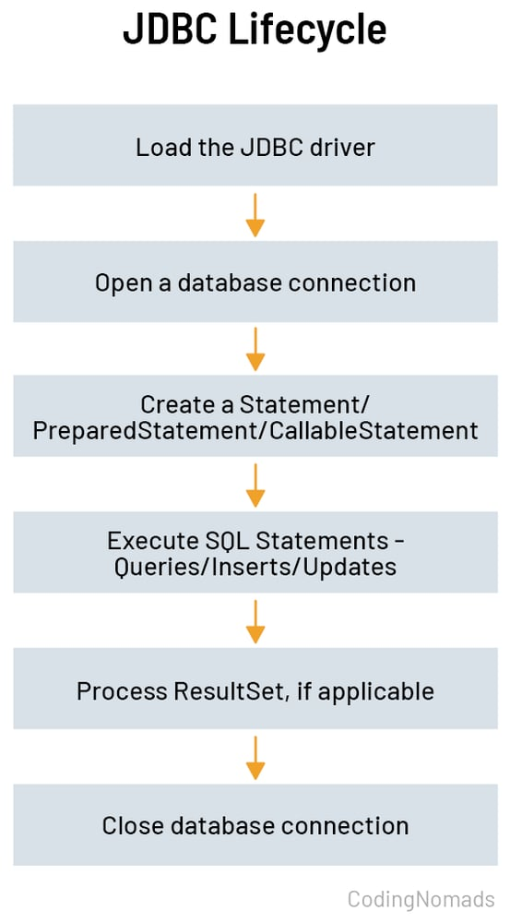
Understand the Basic Steps
To establish a connection with a sa database and retrieve the desired results, we need to perform various steps.
Steps that need to be performed to implement JDBC in Java application:
    Load and Register the driver (optional form JDBC 4.0+ onwards)
    Obtaining connection
    Create a JDBC statement object
    Execute SQL statement
    Process the Results
    Close the connection

Slide 51
Registering a Driver:
  There are three approaches:
    Using registerDriver() of DriverManager class
    DriverManager.registerDriver(new com.mysql.cj.jdbc.Driver());
    2. Using Class.forName()
    Class.forName("com.mysql.cj.jdbc.Driver");
    3. Using System property
    System.setProperty("jdbc.drivers", "com.mysql.cj.jdbc.Driver");
Note: This step is optional from JDBC 4.0 because getConnection() method of the DriverManager class is enhanced to suport JAVA Standard Edition Service Provider Mechanism
JDBCApp.java

Slide 52
Establishing a connection using DriverManager
URL -> jdbc:<subprotocol>:<info> (<subname>)
Method Signature | Description
getConnection(String url) | Used when authentication is not required or handled in URL.
getConnection(String url, Properties info) | Passes properties like user and password in a Properties object.
getConnection(String url, String user, String password) | Most common form, passing credentials explicitly.
Component | Example Value | Meaning
jdbc: | (constant) | Indicates this is a JDBC URL.
<subprotocol> | mysql, oracle, postgresql | Specifies the database type / driver.
<subname> or<info> | database-specific | Contains the server address, port, database name, and options.

Slide 53
Creating a JDBC Statement object – What type of SQL statement you are going to execute.
  We can execute SQL statements only after creating the JDBC statement object.
    Statement
    PreparedStatement
    CallableStatement
Method | Purpose
executeQuery(String sql) | Executes a SELECT query and returns a ResultSet.
executeUpdate(String sql) | Executes INSERT, UPDATE, or DELETE, returns number of rows affected.
execute(String sql) | Executes any SQL statement; returns true if a ResultSet object is returned.

Slide 54
Executing SQL Statements: After creating Statement object, sthis object can be used to excute SQL statements
Method | Purpose
executeQuery(String sql) | Executes a SELECT query and returns a ResultSet.
executeUpdate(String sql) | Executes INSERT, UPDATE, or DELETE, returns number of rows affected.
execute(String sql) | Executes any SQL statement; returns true if a ResultSet object is returned.
If statement produces a ResultSet object after executing SQL statement, the ResultSet instance is used to retrieve the results.
  while (rs.next()) {
  System.out.println(rs.getInt("rollno") ;
  }
Finally close the connection.
connection.close()

Slide 55
ResultSet Interface in JDBC
The ResultSet interface in JDBC (Java Database Connectivity) is used to represent the data retrieved from a database after executing a query.
It provides methods to read, navigate, and manipulate query results.
Key Points of ResultSet Interface
  It is part of the java.sql package.
  Created when you execute a SELECT query using a Statement, PreparedStatement, or CallableStatement.
  Acts like a cursor that points to one row of the result set at a time.

Slide 56
Commonly used methods
Method Name | Purpose
boolean next() | Moves the cursor to the next row. Returns false if no more rows.
int getInt(String columnLabel) | Retrieves an integer from the specified column name.
String getString(String columnLabel) | Retrieves a string from the specified column name.
double getDouble(String columnLabel) | Retrieves a double from the specified column name.
boolean first() | Moves cursor to the first row (only for scrollable ResultSets).
boolean last() | Moves cursor to the last row (scrollable).
boolean previous() | Moves cursor to the previous row (scrollable).
void close() | Closes the ResultSet object.
boolean absolute(int row) | Moves cursor to the specified row number.
boolean relative(int rows) | Moves cursor relative to current row.

Slide 57
Method | Meaning
boolean isBeforeFirst() | Before the first row.
boolean isAfterLast() | After the last row.
boolean isFirst() | Currently on the first row.
boolean isLast() | Currently on the last row.

Slide 58
Types of ResultSet
Type Constant | Description
ResultSet.TYPE_FORWARD_ONLY (default) | Cursor moves only forward. (Default)
ResultSet.TYPE_SCROLL_INSENSITIVE | Cursor can move both forward and backward; does not reflect database changes.
ResultSet.TYPE_SCROLL_SENSITIVE | Cursor can move both forward and backward; reflects database changes.
Concurrency Modes
Constant | Description
ResultSet.CONCUR_READ_ONLY (Default) | Cannot update the database through the ResultSet.
ResultSet.CONCUR_UPDATABLE | Can update the database through the ResultSet.
Statement stmt = con.createStatement(ResultSet.TYPE_SCROLL_INSENSITIVE, ResultSet.CONCUR_READ_ONLY);

Slide 59
Working with Batch updates: with the Statement object
A batch update in JDBC allows you to send multiple SQL statements to the database in one round-trip.
This reduces network traffic and improves performance significantly, especially when executing a large number of insert, update, or delete operations.
Advantages of Batch Updates
Better performance due to reduced database round-trips.
Easy to group logically related operations.
Useful in bulk insert/update/delete operations.

Slide 60
Method | Description
addBatch(String sql) | The addBatch() method of Statement, PreparedStatement, and CallableStatement is used to add individual statements to the batch.
int[] executeBatch() | The executeBatch() is used to start the execution of all the statements grouped together. The executeBatch() returns an array of integers, and each element of the array represents the update count for the respective update statement.
clearBatch() | Just as you can add statements to a batch for processing, you can remove them with the clearBatch() method. This method removes all the statements you added with the addBatch() method. However, you cannot selectively choose which statement to remove.

Slide 61
Steps to be followed
Create a Statement object using either createStatement() methods.
Set auto-commit to false using setAutoCommit().(Optional Statement)
Add as many as SQL statements you like into batch using addBatch() method on created statement object.
Execute all the SQL statements using executeBatch() method on created statement object.

Slide 62
PreparedStatement interface
The PreparedStatement interface creates an object that represents a precompiled SQL statement.
A SQL statement is pre-compiled and stored in a PreparedStatement object. This object can then be used to efficiently execute SQL statement multiple times.
    Note: The setter methods for setting IN parameter values must specify types that are compatible with the defined SQL type of the input parameter. For instance, if the IN parameter has SQL type INTEGER, then the method setInt should be used.
public interface PreparedStatement extends Statement

Slide 63
Return Type | Method | Description
boolean | execute() | Executes any kind of SQL statement.
ResultSet | executeQuery() | Executes the SQL query(select) in this PreparedStatement object and returns the result set generated by the query.
int | executeUpdate() | Executes the SQL INSERT, UPDATE or DELETE statement in this PreparedStatement object.
void | setBoolean (int parameterIndex, boolean x) | Sets the designated parameter to a Java boolean value.
void | setDate(int parameterIndex, Date x) | Sets the designated parameter to a java.sql.Date value.
void | setDouble(int parameterIndex, double x) | Sets the designated parameter to a Java double value.
void | setFloat(int parameterIndex, float x) | Sets the designated parameter to a Java float value.
void | setInt (int parameterIndex, int x) | Sets the designated parameter to a Java int value.
void | setLong(int parameterIndex, long x) | Sets the designated parameter to a Java long value.

Slide 64
void | setNull (int parameterIndex, int sqlType) | Sets the designated parameter to SQL NULL.
void | setString (int parameterIndex, String x) | Sets the designated parameter to a Java String value.
void | setTime (int parameterIndex, Time x) | Sets the designated parameter to a java.sql.Time value.

Slide 65
Statement | PreparedStatement
It is used when SQL query is to be executed only once with same data. | It is used when SQL query is to be executed multiple times with different data.
Performance is very low. | Performance is better than Statement.
It is base interface. | It extends statement interface.
Used to execute normal SQL queries. | Used to execute dynamic SQL queries.
For every execution compilation takes place | Compilation only one time

Slide 66
Procedure
Function
IN
OUT
INOUT

Slide 67
CallableStatement
To call a stored procedure from the database we have to use CallableStatement interface
  CallableStatement cs = con.prepareCall(“{call proc_name(?,?)}”);
Driver S/W will implement the interfaces
JDBC Types - JDBC “BRIDGE” Types
Java Types | JDBC Types | Database Types
int | Types.INTEGER | int, number
float, double | Types.FLOAT, Types.DECIMAL, Types.DOUBLE | Float, double
String | Types.VARCHAR | varchar,varchar2
Java.sql.Date | Types.DATE | date
. . | . . | . .

Slide 68
Procedure
DELIMITER //
CREATE [or REPLACE] PROCEDURE procedure_name [[IN | OUT | INOUT] parameter_name datatype [, parameter datatype]) ]
BEGIN
Declaration_section
Executable_section
END //
DELIMITER;
CALL procedure_name ( parameter(s));

Slide 69
Steps to call stores Procedure
Make sure stored procedure is in database.
Create a callable statement interface object
Provide values for every IN parameter by using corresponding setter methods.
For every OUT parameters we have to register with JDBC types.
Execute Procedure call.
Get results by using getter methods from OUT parameter.

Slide 70
Create a callable statement interface object
CallableStatement cs = con.prepareCall("{call emp_sal(?,?)}");
Provide values for every IN parameter by using corresponding setter methods.
cs.setXXX(1, value);
For every OUT parameters we have to register with JDBC types.
cs.registerOutParameter(2, Types.XXX);
Execute Procedure call.
  cs.execute()
Get results by using getter methods from OUT parameter.
  cs.getXXX(2)

Slide 71
Creation of Procedure in MySQL – Procedure language
DELIMITER //
CREATE PROCEDURE AddNumbers()
BEGIN
DECLARE num1 INT DEFAULT 10;
DECLARE num2 INT DEFAULT 20;
DECLARE result INT;
SET result = num1 + num2;
SELECT CONCAT('The sum is ', result) AS Output;
END //
DELIMITER ;
CALL PROCEDURE AddFixedNumbers();
Void AddNumbers()
{
int num1=10;
int num2=20;
int result;
result=num1+num2;
System.out.println(“The Sum is”+result);
}

Slide 72
Creation of Procedure in MySQL – Procedure language
DELIMITER //
CREATE PROCEDURE AddNumbers(
IN num1 INT, IN num2 INT)
BEGIN
DECLARE result INT;
SET result = num1 + num2;
SELECT CONCAT('The sum is ', result) AS Output;
END //
DELIMITER ;
CALL PROCEDURE AddFixedNumbers(10,20);
Void AddNumbers(int num1, int num2)
{
int result;
result=num1+num2;
System.out.println(“The Sum is”+result);
}

Slide 73
Creation of Procedure in MySQL – Procedure language
DELIMITER //
CREATE PROCEDURE AddNumbersWithOut(
IN num1 INT, IN num2 INT, OUT Result INT)
BEGIN
SET result = num1 + num2;
END //
DELIMITER ;
int AddNumbers(int num1, int num2)
{
int result;
result=num1+num2;
return result;
}
SET @output = 0;
CALL AddTwoNumbersWithOut(15, 25, @output);
SELECT @output AS Total;

Slide 74
Creation of Procedure in MySQL – Procedure language
DELIMITER //
CREATE PROCEDURE UsingINOUT(
INOUT num1 INT)
BEGIN
SET num1= num1 * num1;
END //
DELIMITER ;
SET @x = 7;
Call usingINOUT(@x);
Select @x;
int SelfAddition(int num1)
{
num1=num1*num1;
return num1;
}

Slide 75
Function Syntax
CREATE FUNCTION Function_Name(input_arguments)
RETURNS data_type
[DETERMINISTIC |READS SQL DATA|NO SQL | CONTAINS SQL]
BEGIN
declare variables;
statements . . . . . . . . . .
return variable;
END
Only IN parameters are allowed in Stored Functions.
Functions:
Can take input (IN) parameters
Must return a single value using the RETURN statement
Cannot use OUT or INOUT parameters like procedures
Even though your syntax shows SQL blocks, MySQL functions are not allowed to do INSERT, UPDATE, DELETE, or call procedures. They can only perform read-only operations like SELECT ... INTO.

Slide 76
Component | Description
CREATE FUNCTION Function_Name(...) | Defines the function with input parameters
RETURNS data_type | Specifies the return data type (e.g., INT, VARCHAR, FLOAT, etc.)
DETERMINISTIC NOT DETERMINISTIC(DEFAULT) ------> | Tells MySQL this function always returns the same result for the same inputs Different Results Ex DATETIME
READS SQL DATA | Allows read-only SQL like SELECT INTO
NO SQL | Declares that the function doesn't use any SQL statements
CONTAINS SQL | Declares that the function contains SQL but no reads/writes
BEGIN ... END | The body of the function
DECLARE variables; | Declare local variables if needed
RETURN ...; | Returns the final result of the function

Slide 77
SQL Data Access Modifiers in MySQL
Modifier | Allowed in Functions? | Reads Data | Modifies Data
NO SQL | Yes | No | No
READS SQL DATA | Yes | Yes | No
MODIFIES SQL DATA | Not allowed in functions | Yes | Yes (Only for procedures)
CONTAINS SQL | Yes (limited use) | Maybe | Maybe

Slide 78
Ex:Adding two numbers
You cannot use CALL for functions in MySQL.
CALL is used only for stored procedures
DELIMITER $$
CREATE FUNCTION add_numbers(a INT, b INT)
RETURNS INT
DETERMINISTIC
BEGIN
RETURN a + b;
END $$
DELIMITER ;
SELECT add_numbers(10, 20);
OR
SET @M;
SELECT add_numbers(20,30) INTO @M;
SELECT @M;

Slide 79
Ex: Non Deterministic
DELIMITER $$
CREATE FUNCTION get_time()
RETURNS DATETIME
NOT DETERMINISTIC READS SQL DATA
BEGIN
RETURN NOW();
END $$
DELIMITER ;
select get_time();

Slide 80
Ex 3:
DELIMITER $$
CREATE FUNCTION get_random()
RETURNS DOUBLE
NOT DETERMINISTIC READS SQL DATA
BEGIN
RETURN RAND();
END $$
DELIMITER ;
select get_random();

Slide 81
ERROR
delimiter //
CREATE FUNCTION update_salary(emp_id INT)
RETURNS INT
DETERMINISTIC
BEGIN
UPDATE employee SET salary = 80000 WHERE emp_id = emp_id;
RETURN 1;
END //
DELIMITER ;
select update_salary(101);

Slide 82
Difference Between Stored Procedure and Stored Functions
Feature | Stored Procedure | Stored Function
Return Type | Does not return a value directly | Must return a single value using RETURN
Invocation Method | Invoked using CALL | Invoked inside SQL (e.g., SELECT func_name(...))
Usage in SQL Statements | SELECT, INSERT, UPDATE.. | Only SELECT, WHERE
OUT/INOUT Parameters | Supports IN, OUT, and INOUT parameters | Only IN parameters allowed
Return Multiple Values | Can return multiple outputs via OUT parameters | Can return only one value
Side Effects (Insert/Update) | Allowed — can modify tables (DML allowed) | Not recommended
Transactional Logic | Suitable for batch or transaction logic | Not preferred for transaction handling
DETERMINISTIC Clause | Optional | Mandatory
READS/NO SQL Clause | Optional | Required based on logic used

Slide 83
Working with Transactions
DBMS manages databases across multiple users and environments.
Transaction – interaction between the user and database.
Transactions ensure data integrity during concurrent access.
DBMS uses ACID properties to maintain consistency.

Slide 84
ACID Properties
Atomicity: Entire transaction happens or none at all.
Consistency: Database remains consistent before and after.
Isolation: Transactions don’t interfere (avoids dirty reads).
Durability: Changes persist after commit, even on crash.

Slide 85
Types of Transactions
Local: Operations within a single database connection.
Distributed: Involves multiple transactional resources.
Nested: Transactions within transactions with rollback control.

Slide 86
Transaction Management in JDBC
Ensures data integrity and consistency.
Transaction Manager coordinates resources.
Resource Manager manages specific resources (DB, files, etc.).
JDBC API supports local and distributed transactions.

Slide 87
AutoCommit, Commit & Rollback
setAutoCommit(true) – individual statement
setAutoCommit(false) - group multiple statements.
commit() - Saves all changes.
rollback() - Discards all changes.
  Useful for managing complex transactions.

Slide 88
Transaction Isolation Levels
READ UNCOMMITTED - Allows dirty reads.
READ COMMITTED - Prevents dirty reads (default in many DBMS).
REPEATABLE READ - Prevents dirty & non-repeatable reads.
SERIALIZABLE - Full isolation, highest level. Performing the transaction one after another.

Slide 89
JDBC Isolation API
setTransactionIsolation(
  Connection.TRANSACTION_SERIALIZABLE
  );
getTransactionIsolation();
Levels:
    NONE,
    READ_UNCOMMITTED,
    READ_COMMITTED,
    REPEATABLE_READ,
    SERIALIZABLE

Slide 90
Savepoints in JDBC
Used to mark intermediate transaction points.
  setSavepoint(name) - Create savepoint.
  rollback(savepoint) - Rollback to that point.
  releaseSavepoint() - Free resources of savepoint.

